Slide 1
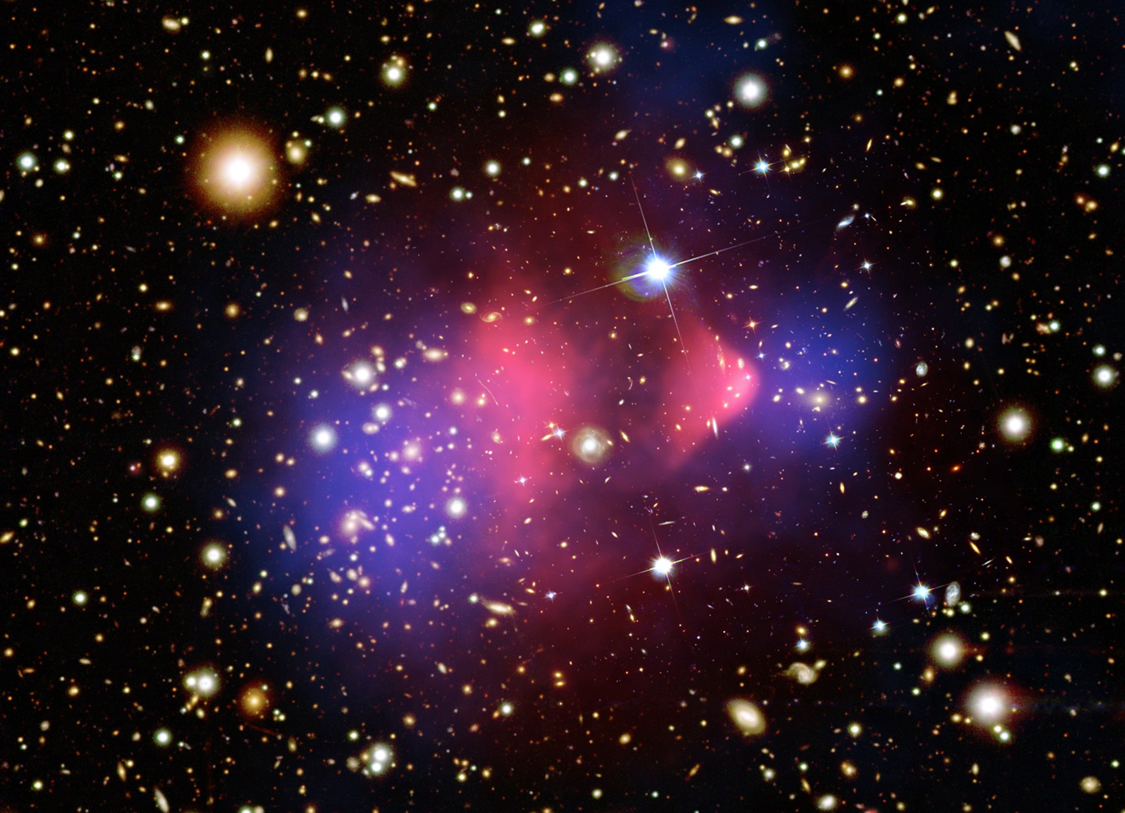
Please come up and get your graded second midterm!

Slide 2
Notes on midterm 2
Overall, way better than midterm 1! Good work!
From what I saw, you knew a lot more, no help needed, than you probably expected you would
Many didn’t try short answer question 1. If you wrote the equation, I gave a point.. Let’s talk about the question!
Beginning with a warning…

Slide 3
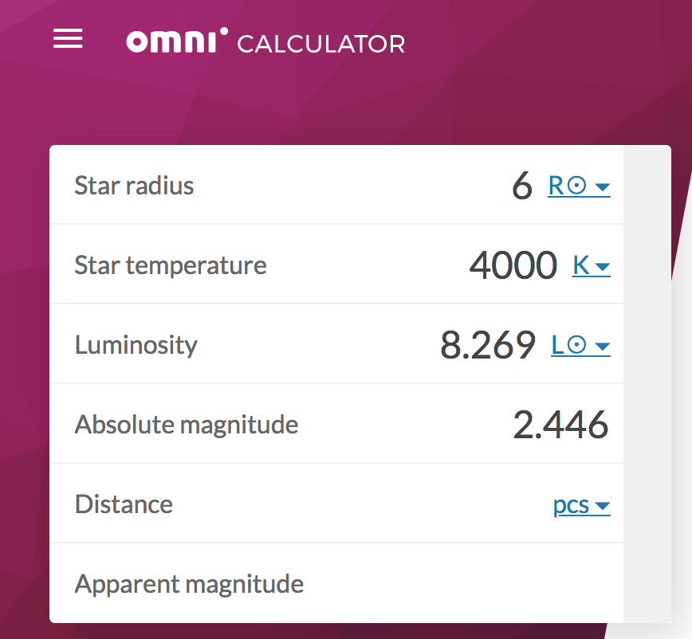
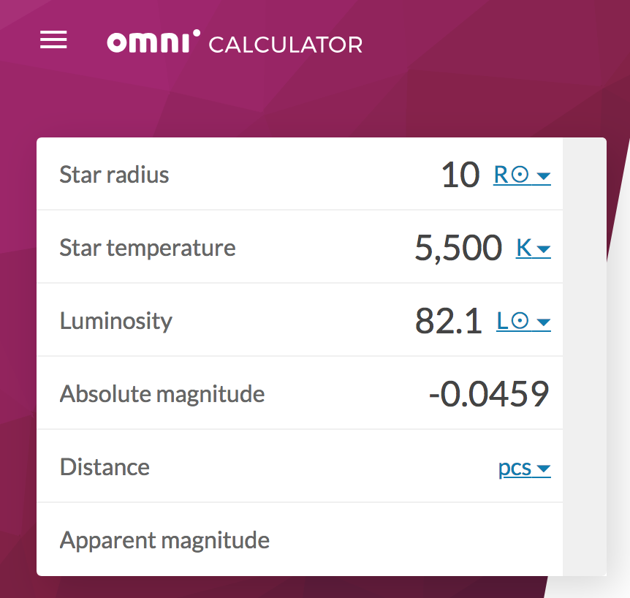
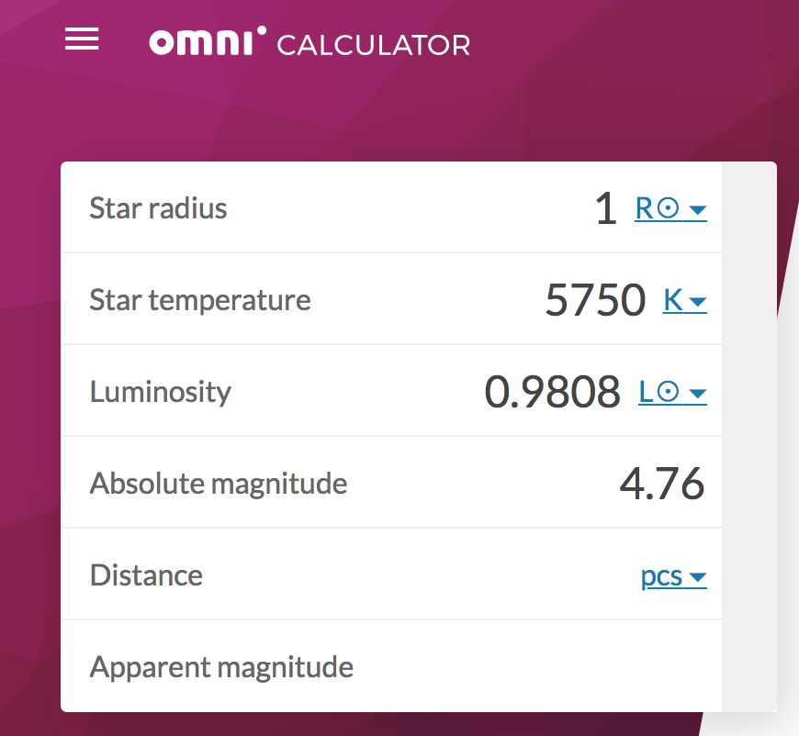
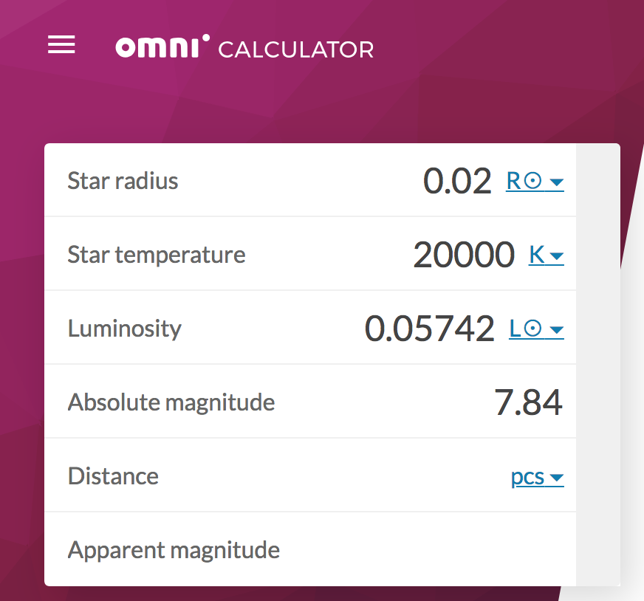
Notes on midterm 2
Yep, I said books/notes/internet were fair game. But, caveat emptor… (buyer beware)
Online tools aren’t always correct (this luminosity calculator is off by a few percent)
You have to show your work for credit
Use tools like this (and Wolfram Alpha) to check, and be sure you can show the math
Please don’t scare your profs. I spent a solid hour trying to figure out why so many students had exactly the same just barely wrong luminosities for the first short answer question (out to five decimal places, even…)

Slide 4
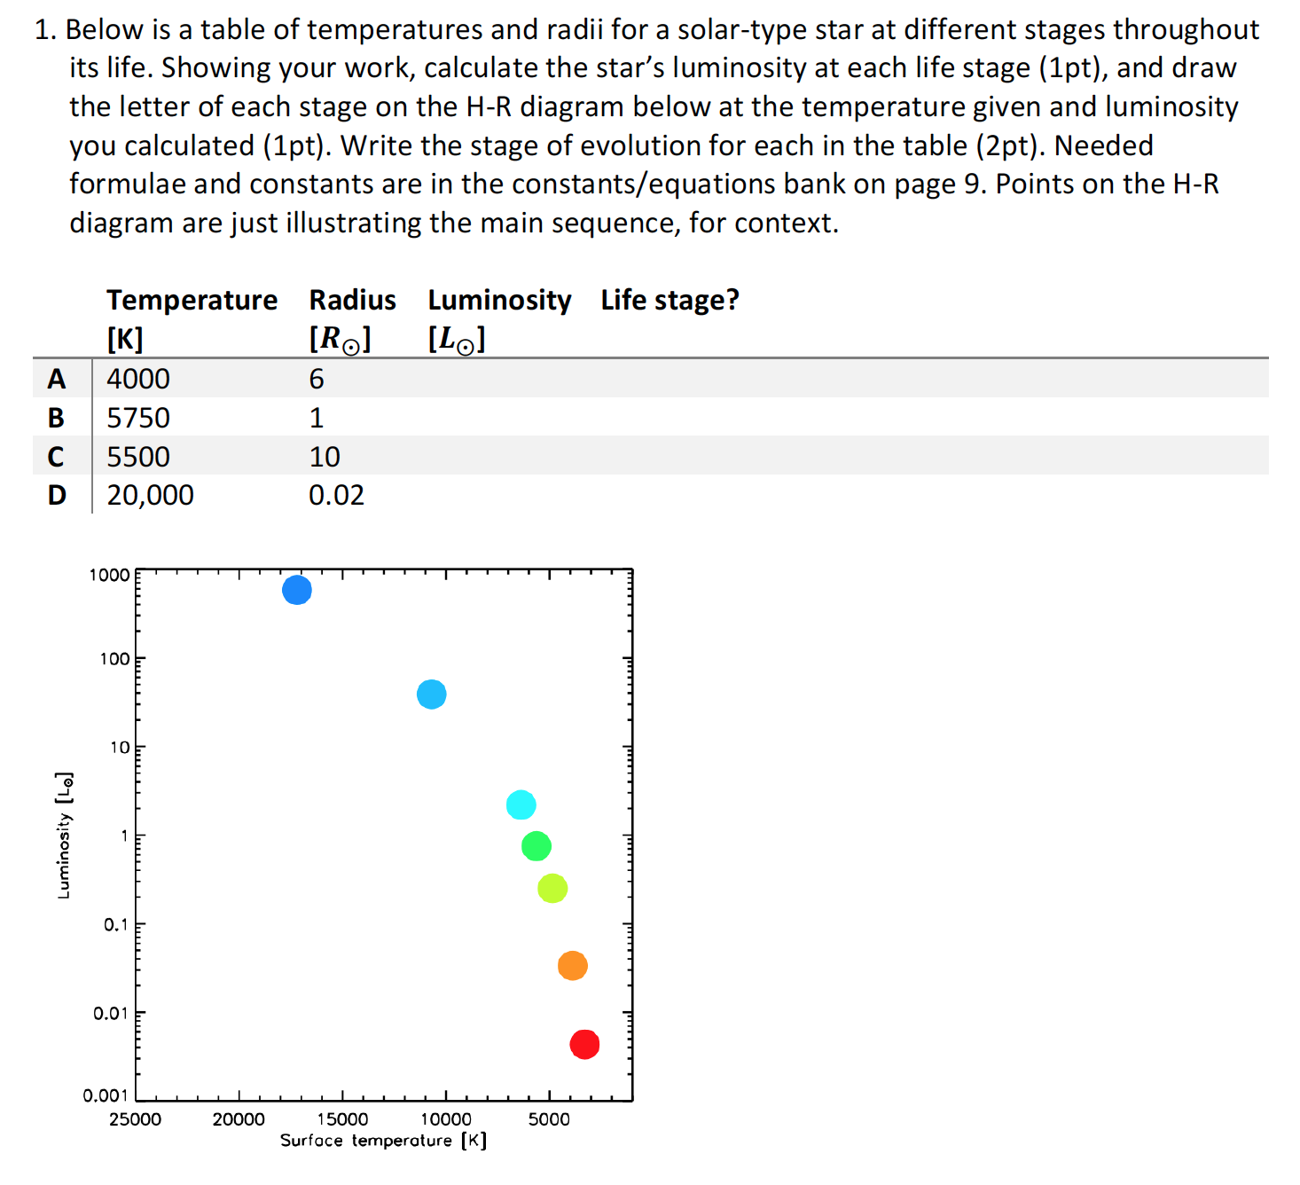
Ok, *that* question

Slide 5
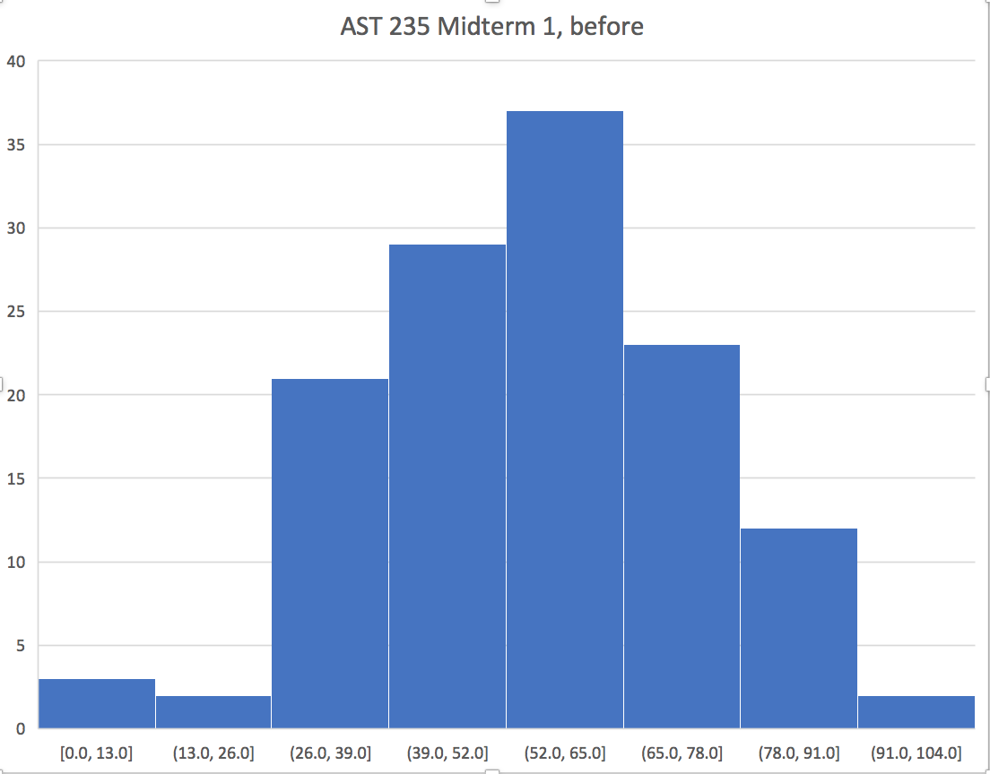
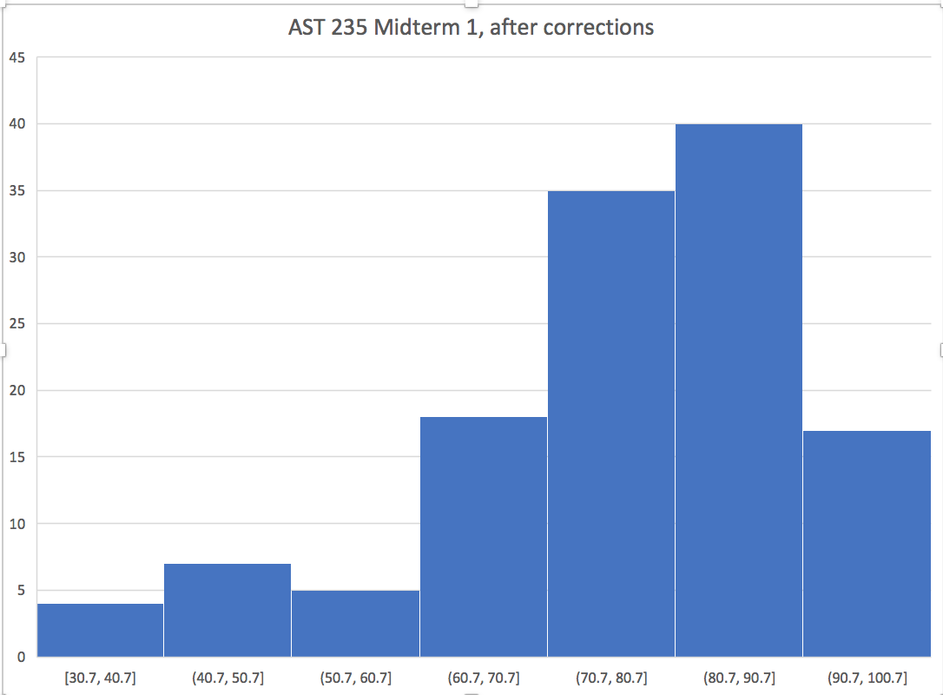
Notes on midterm 2
Notes:
Highest bin in ‘before’ category isn’t scaled right; there were no scores above 100 on the ‘before’ corrections test
On the ‘after’, the highest score was 100.

Slide 6
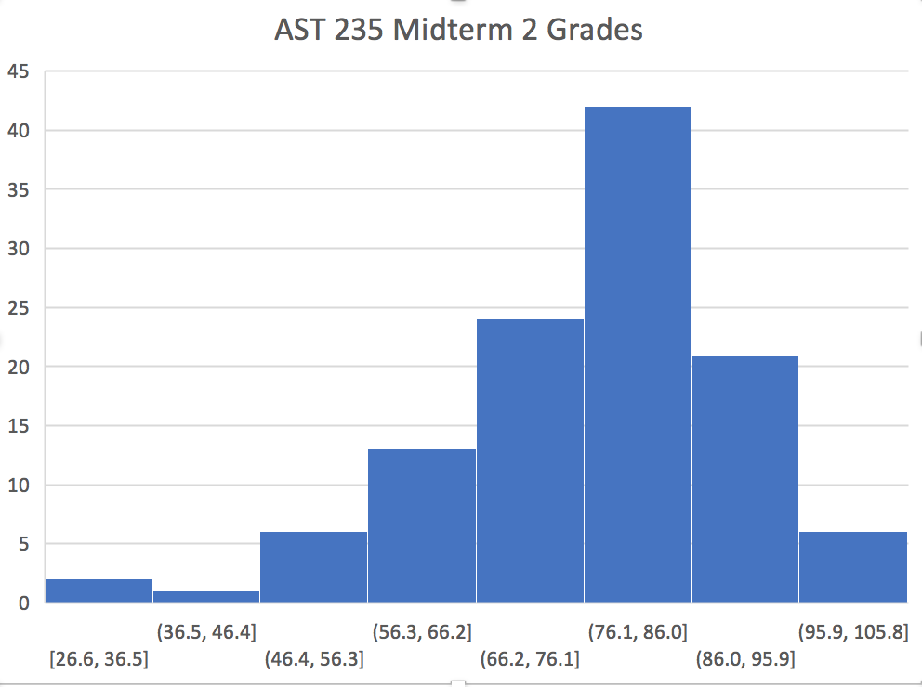
Notes on midterm 2
Here’s what we’re going to do—time is limited!
Group corrections
Get into groups of at least 4
E-mail me a group answer sheet + short answers/bonuses written up
I will average your group test grade with your solo grade (unless your solo grade was higher)
E-mail me these corrections by 11/29
Notes:
I want you to get together to study for the final, and I want you to be able to keep your tests for studying with
On this test there actually was someone who got 105, the highest bin is correctly bounded in this plot

Slide 7
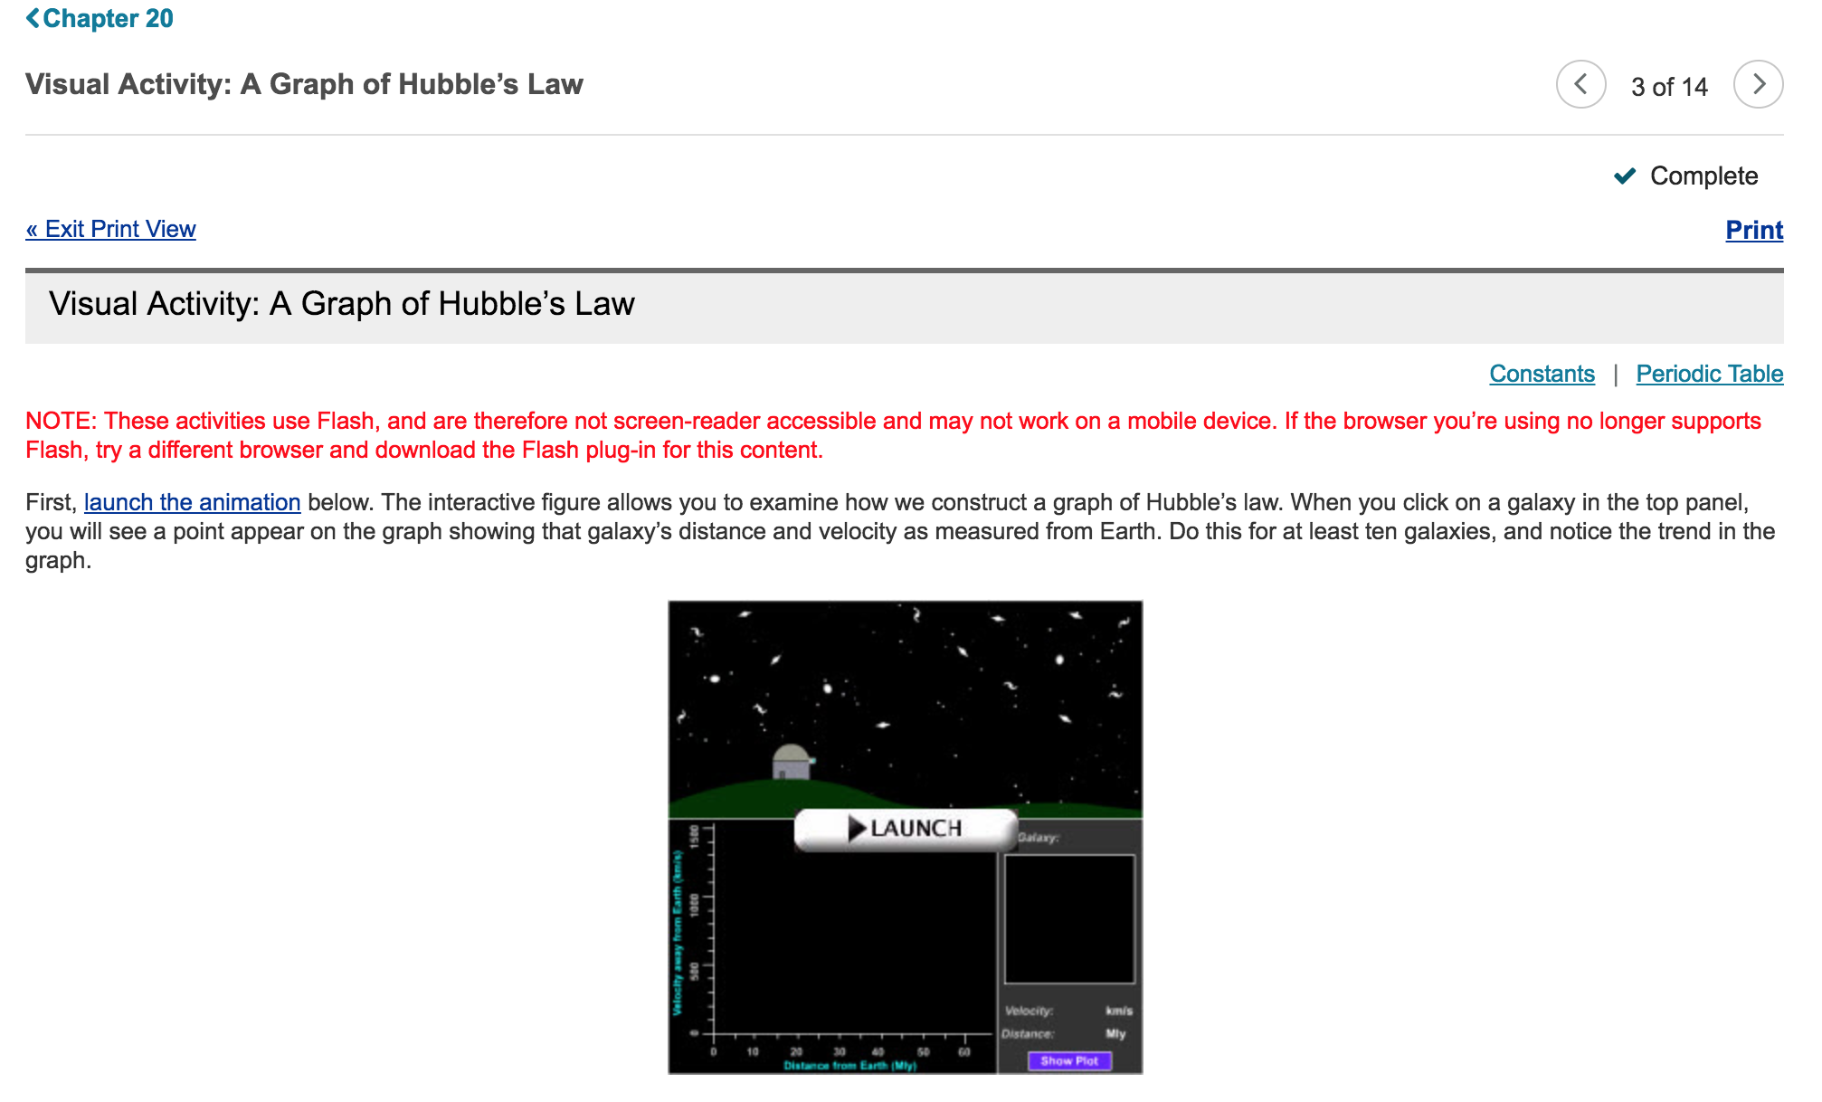
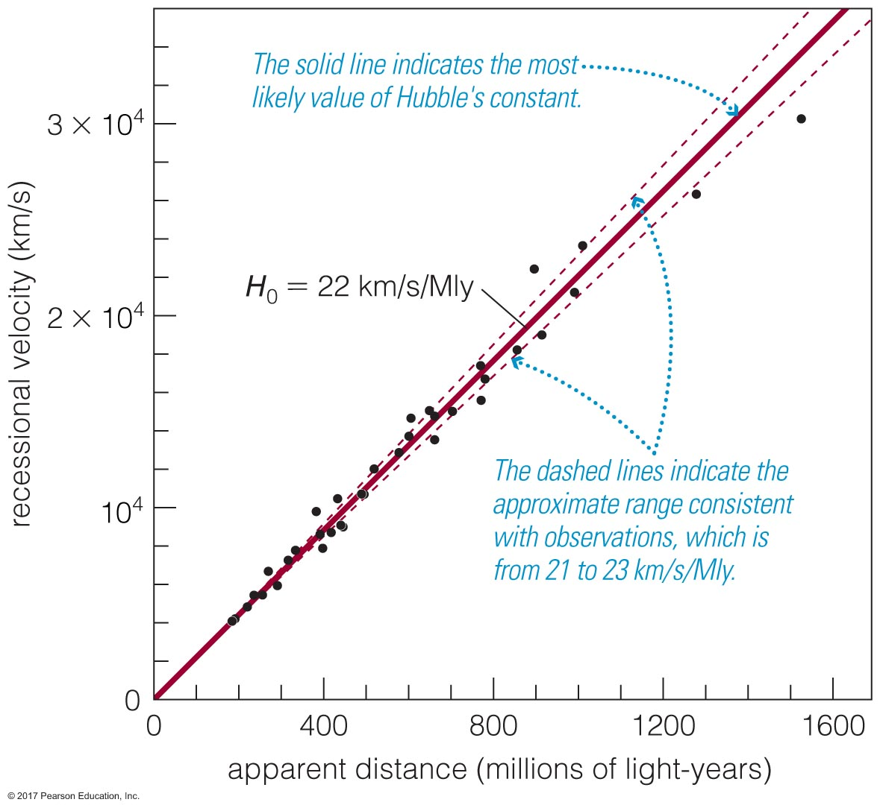
Homework notes
Oops on Chapter 20- interactive graphic won’t load
All the questions are about Hubble’s law- you can use figure from the book (20.21) to answer the questions:

Slide 8
Last class notes—clickers
Bring your clickers to the last two classes- turning them in Tuesday 11/27!
If you forget to return it, Physics department puts a $10 hold on your account
I don’t know what badness this leads to, probably registration issues, graduation issues.. Pls return clickers

Slide 9
Notes on the final!
Will be Tuesday, December 4th, from 12-3pm in this room
It will not take 3 hours.
Bring your books (or e-text)

Slide 10
A few more notes on the Big Bang
Theory is meant to describe evolution of the universe, not necessarily its origin
In Planck Era, since we don’t understand the physics of the universe under these conditions, can we really know whether laws of thermodynamics as we define them today, in the conditions of today’s universe, would apply?
Importance of observations
Always keeps us grounded to something
Basis of the scientific method!
Observe
Hypothesize
Test
Revise
Lather, rinse, repeat…

Slide 11
Dark matter, dark energy, the fate of the universe
Chapter 23. The Comic Perspective

Slide 12
What is the universe made of?
lol idk
(No really; we don’t know.)
Simply expressed, there is:
What we can see
What we can’t but think is there
Notes:
http://cms.web.cern.ch/news/recipe-universe

Slide 13
What is the universe made of?
What we can see
What we can’t but think is there
Massive stars
Low-mass stars
Galaxies
Molecular clouds
Exoplanets
Asteroids
Black holes
Neutron stars
Dark matter
Antimatter
Neutrinos
Notes:
Let’s fill in some examples..

Slide 14
Something something dark side
Dark matter generally refers to whatever unseen influence is causing observed gravitational effects
Is it actually dark? Not necessarily: this term just means it doesn’t interact with light. Maybe it’s transparent matter
Dark energy generally refers to the source of the unseen force
Aka quintessence, or
A cosmological constant
Like the Big Bang theory, a universe with dark matter and dark energy seems strange, but…
Ideas produce testable predictions
Data have supported interpretations using dark matter, dark energy

Slide 15
Galactic rotation, dark matter
How do we know galaxies rotate?
Observe how smaller parts of them move
Atomic H at 21cm in clouds!
Compare those observations to physics
What’s weird about galactic rotation is one of Astronomy’s biggest, neatest mysteries
Who predicted it? Fritz Zwicke
Who observed it? Vera Rubin and W. Kent Ford, Jr.
Notes:
This slide is from lecture 2!
Hidden figure alert! Vera Rubin passed away in late 2016, passed over year after year for the Nobel prize in Physics. I was lucky enough to know her, she was a lovely, kind, and brilliant person. https://en.wikipedia.org/wiki/Vera_Rubin
http://adsabs.harvard.edu/abs/1970ApJ...159..379R → the actual paper published in 1970
https://astrobites.org/2016/12/27/how-one-person-discovered-the-majority-of-the-universe-the-work-of-vera-rubin/

Slide 16
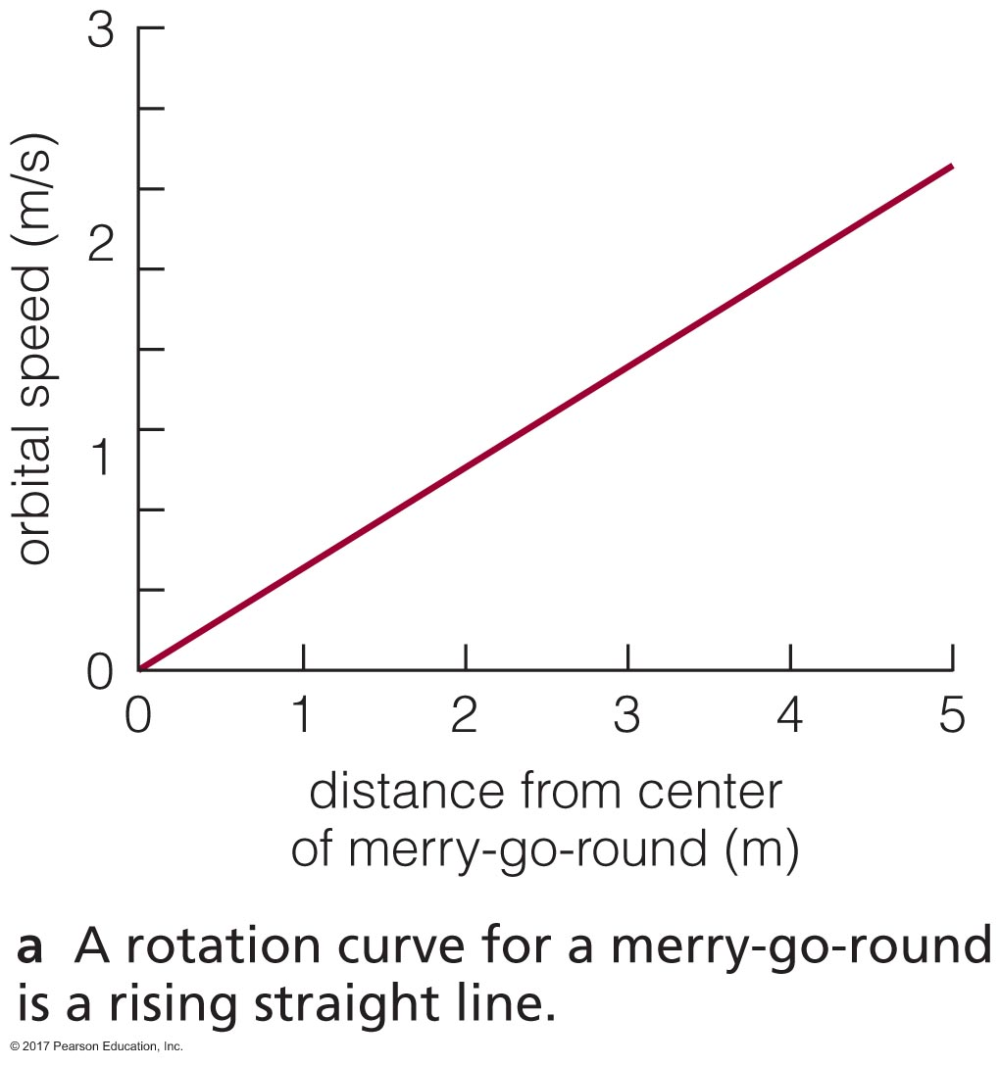
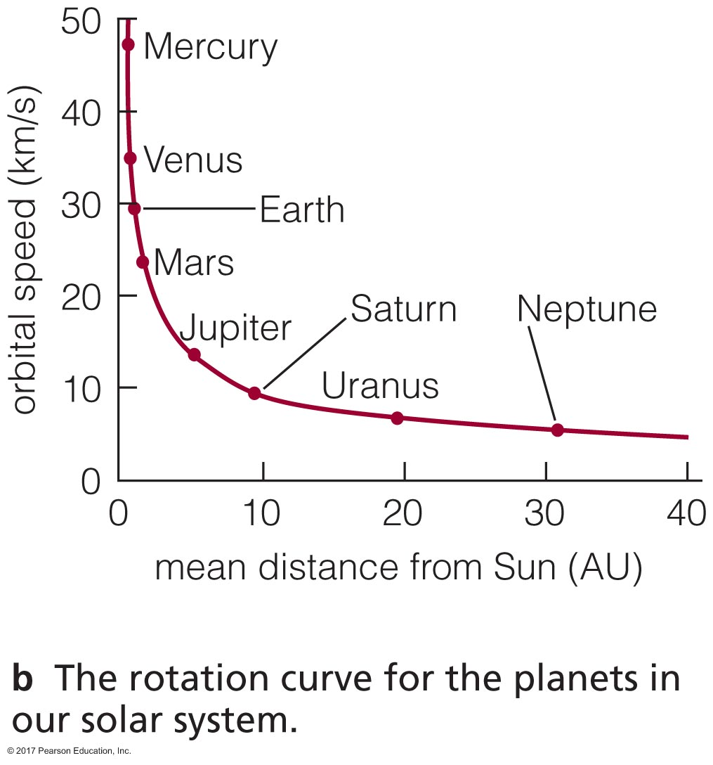
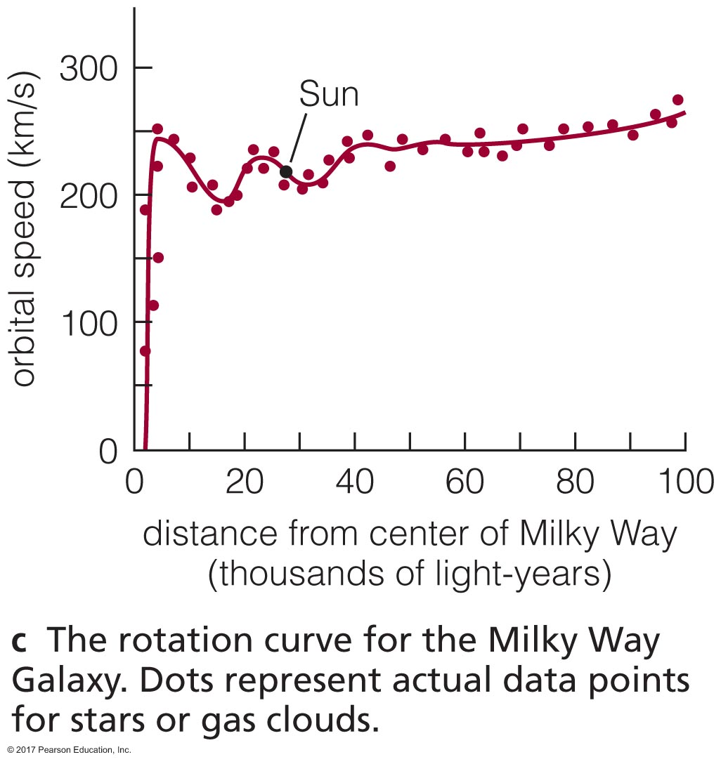
Dark matter
A closer look at ”rotation curves”
Something solid Our solar system Our galaxy
Calculating mass in galaxy from rotation curves, 10x more mass than what we see in stars and gas!
Notes:
Galaxy curve implies more mass within each measured point’s radius around the milky way than simple Keplerian models would predict
Another salient point here, we don’t notice effects of dark matter in the solar system

Slide 17
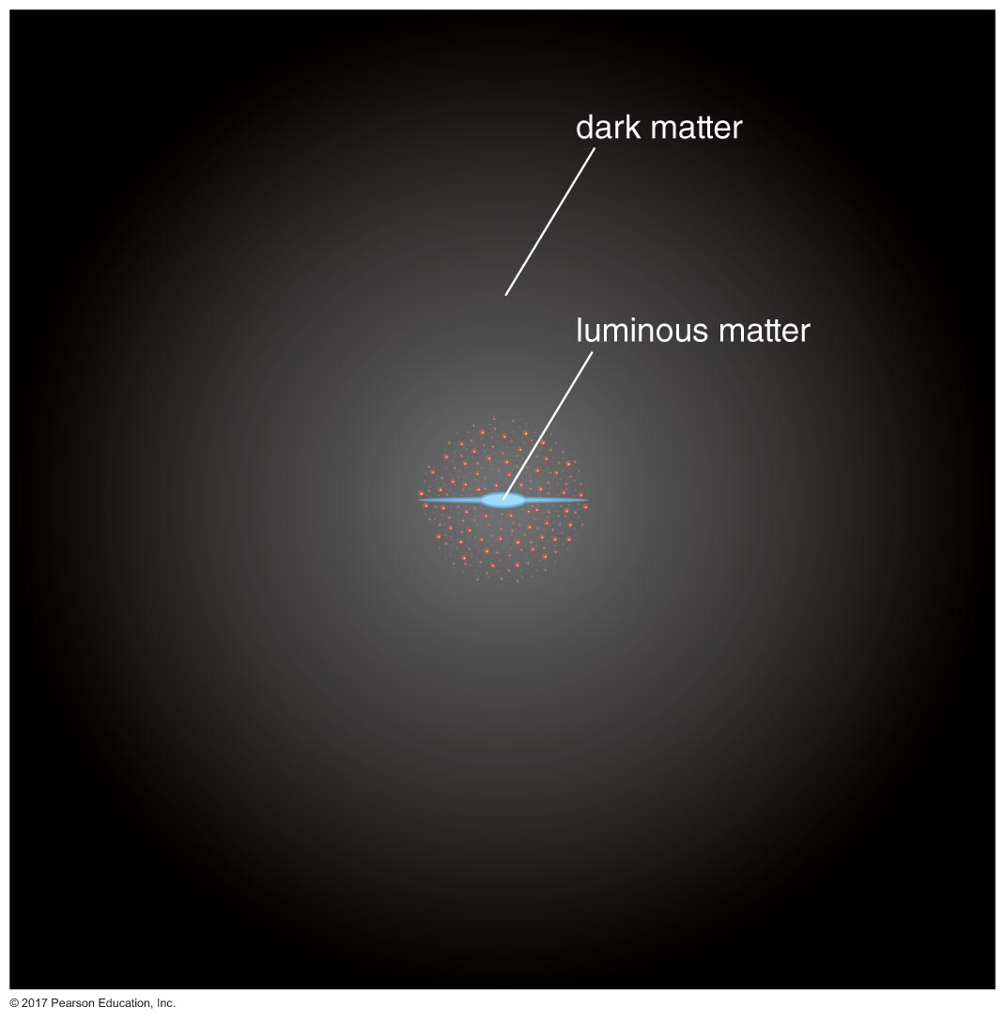
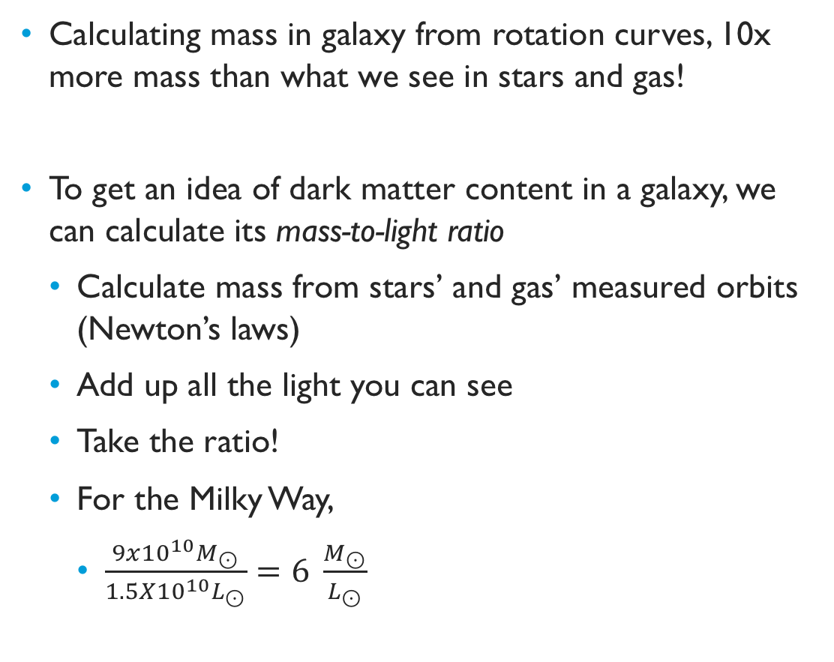
Dark matter
Calculating mass in galaxy from rotation curves, 10x more mass than what we see in stars and gas!
To get an idea of dark matter content in a galaxy, we can calculate its mass-to-light ratio
Calculate mass from stars’ and gas’ measured orbits (Newton’s laws)
Add up all the light you can see
Take the ratio!
For the Milky Way,
$\frac{9x{10}^{10}M_{⊙}}{1.5X{10}^{10}L_{⊙}}=6 \frac{M_{⊙}}{L_{⊙}}$
Notes:
Considering the Sun’s mass to luminosity ratio is 1, this means most of the milky way’s mass is less luminous per unit mass than the sun.

Slide 18
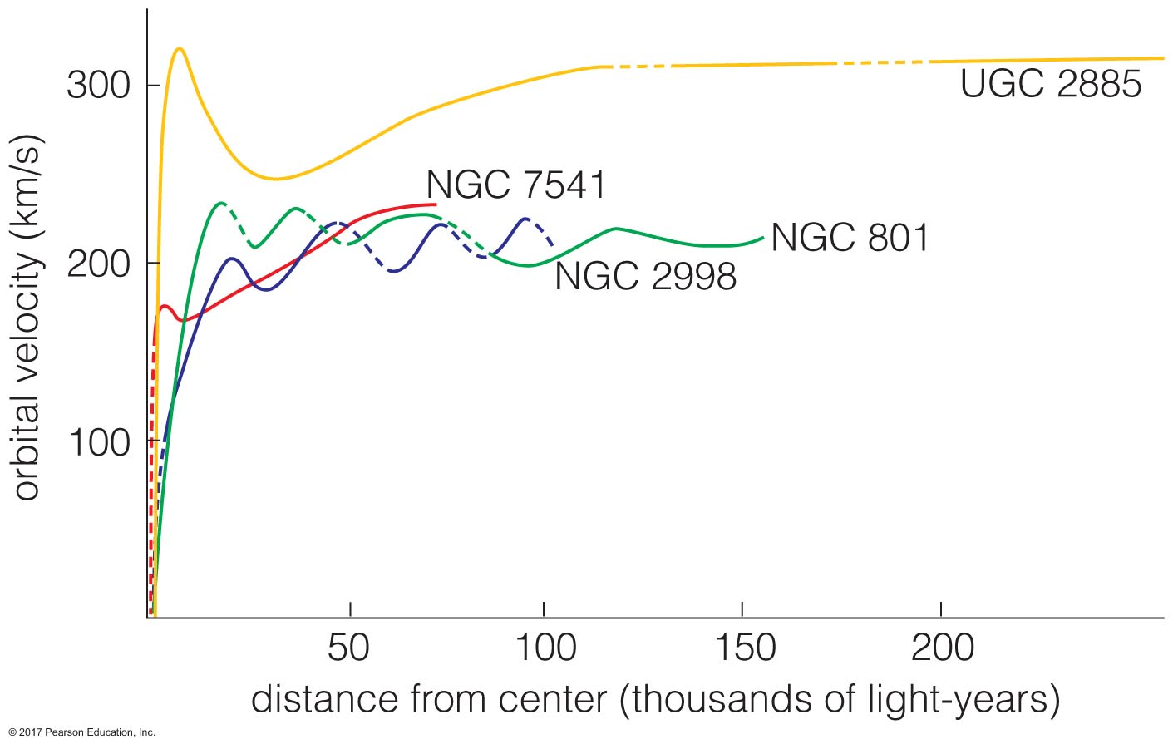
Dark matter outside the Milky Way
Can calculate a galaxy’s mass-to-light (M/L) ratio
As long as we know distance to the galaxy (to convert apparent brightness into luminosity)
And the galaxy’s mass
Easy peasy! …for spiral galaxies. Little bit harder for elliptical galaxies, but doable:
Measure spectral lines of galaxy at various distances from center, use Doppler broadening
Better: use globular clusters’ motions in elliptical galaxies
On average, galaxies appear to have ~10x more mass in dark matter than in stars.
Notes:
How do we calculate distances to galaxies?
How do we calculate masses of galaxies?

Slide 19
Dark matter in galaxy clusters
How to calculate M/L in a cluster?
Measure cluster mass
using orbits of galaxies around center of cluster
measure redshift of all the galaxies in the cluster
figure out redshift of the cluster as a whole
subtract that, and you’re left with radial velocities of individual galaxies
Notes:
Just like the cluster of galaxies were a cluster of stars—same physics applied! Use Newton’s laws to get the mass of the cluster from the orbits of the galaxies in the cluster
https://www.spacetelescope.org/images/opo9610a/

Slide 20
Dark matter in galaxy clusters
How to calculate M/L in a cluster?
Measure cluster mass
using orbits of galaxies around center of cluster
using X-ray emission of hot gas between galaxies
hot gas is observed within and surrounding clusters of galaxies
it is in gravitational equilibrium with the cluster
average kinetic energy (temperature, speeds) of gas particles related to F_{g}! and therefore the cluster’s mass
Notes:
https://phys.org/news/2017-08-galaxy-clusters-clues-dark-energy.html

Slide 21
Dark matter in galaxy clusters
How to calculate M/L in a cluster?
Measure cluster mass
using orbits of galaxies around center of cluster
using X-ray emission of hot gas between galaxies
observing how clusters lens background galaxies
use Einstein’s theory of general relativity to calculate how much mass is bending images of background galaxies
Notes:
https://www.smithsonianmag.com/science-nature/cosmic-lensing-explained-180960136/

Slide 22
Dark matter in galaxy clusters
How to calculate M/L in a cluster?
Measure cluster mass
using orbits of galaxies around center of cluster
using X-ray emission of hot gas between galaxies
observing how clusters lens background galaxies
use Einstein’s theory of general relativity to calculate how much mass is bending images of background galaxies
Prof. Keren Sharon, UMich, studies strongly lensed galaxies using Hubble
Has found quasars (active galactic nuclei) in distant, lensed galaxies!
Notes:
https://lsa.umich.edu/astro/people/core-faculty/kerens.html

Slide 23
Dark matter in galaxy clusters
How to calculate M/L in a cluster?
Measure cluster mass
using orbits of galaxies around center of cluster
using X-ray emission of hot gas between galaxies
observing how clusters lens background galaxies
All three methods agree: most galaxy clusters have 40x more mass in dark matter than stars and gas!

Slide 24
Interacting galaxy clusters
Notes:
This is the Bullet Cluster. It is two galaxy clusters that have collided/passed through each other. The pink color is showing where the hot X-ray emitting gas is, and the blue light is basically drawn on, it’s showing where gravitational lensing measurements have determined most of the two clusters’ mass is concentrated. This is considered the strongest evidence yet for dark matter because the vast majority of the mass is not where the most light is coming from. The gas contains more mass than the stars in either galaxy cluster (remember, most of the gas in the universe isn’t in stars- it’s just hanging out!) but yet, the mass we measure isn’t lined up with the gas! Super weird, and hard to explain with any model we have right now other than dark matter
https://en.wikipedia.org/wiki/Bullet_Cluster

Slide 25
What’s the (dark) matter?
Could be ordinary, could be extraordinary!
Ordinary matter, aka baryonic matter
Made of baryons, the category of particles that protons and neutrons are in
Exotic matter, nonbaryonic, includes particles in other categories
Leptons– include electrons, neutrinos

Slide 26
How much do we need?
Let’s back up a step. Decades have shown we can’t observe it yet, only infer it, so let’s try to figure out how much of whatever it is we need based on the universe we observe and then go backwards to figure out what we have (based on Big Bang models) that’s about that much
To do this, let’s think about the geometry of the universe.

Slide 27
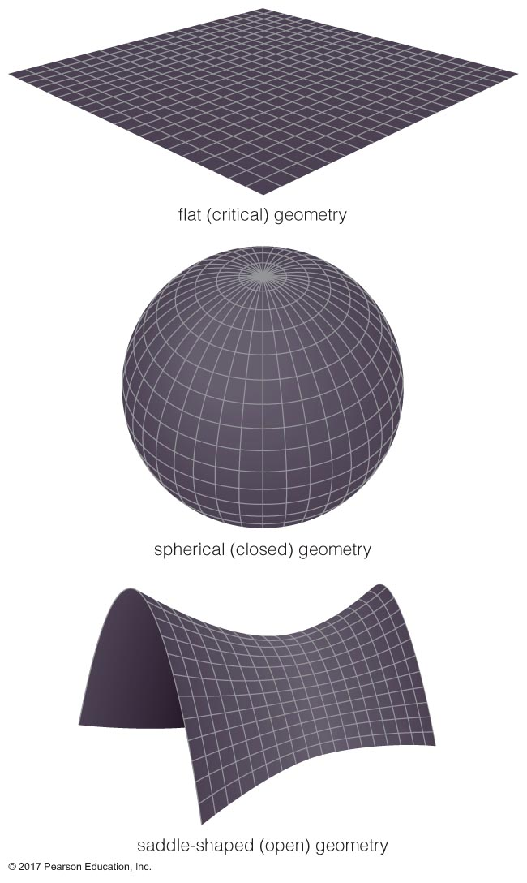
Geometry of the universe
Einstein’s theory of general relativity notes mass distorts space-time
GR predicts that geometry of universe depends on the distribution of matter and energy in the universe
Critical density is defined as where the universe won’t continue to expand indefinitely, but won’t collapse back onto itself, either
Flat
Combined density of matter and energy close to a critical value
Spherical
Average density greater than critical density
Saddle-shaped
Average density less than critical density

Slide 28
Geometry of the universe
So, ok. We think we’re in a “flat” universe—we hope so, anyway. Alternatives aren’t super:
Closed geometry would mean universe’s fate is to collapse back in on itself: gravity wins
Open geometry would mean universe’s fate is to expand forever: dark energy wins
We’ll talk about implications for the fate of the universe in a few slides…
but for now, we need to use criticality to figure out if we have enough of anything to account for dark matter!

Slide 29
How much do we need?
Measuring mass, calculating a volume it occupies, you obtain average density
This is done for dark matter, stars, gas
These densities then compared to the critical density needed for universe to be flat
Average densities we observe are:
Stars: 0.5% of critical density
Dark matter: 25% of critical density

Slide 30
How much do we have?
Ok, so let’s take stock of what’s in the universe pantry
5% of critical density: baryonic matter
Big Bang nucleosynthesis predictions
CMB observations (variations in temperature are mapping variations in density)
Not enough!
[unknown]% of critical density: nonbaryonic matter

Slide 31
How much do we have?
Nonbaryonic matter: we don’t really know
What it is
How much of it we have
So it’s a great candidate for dark matter!
We have some ideas, though.

Slide 32
Nonbaryonic dark matter candidates
Neutrinos
There are a lot of ‘em
But they interact weakly, would pass through those clusters of galaxies unfazed
…ok but what about, like neutrinos, but heavier and slower?
WIMPs: Weakly Interacting “Massive” Particles
Not really massive, but massive enough for our missing matter problem
Mutual gravity might hold a bunch of them together
Completely invisible in all wavelengths
Winner winner, WIMPy dinner… we have a leading candidate!
Today in science– Large Hadron Collider searching for evidence of WIMPs

Slide 33
Structure of the universe
Dark matter handily solves an interesting problem: how did structure first form in the universe, anyway?
Gravity is locally winning over expansion of universe: solar system, Milky Way, Local Group and clusters of galaxies not being pulled apart by dark energy-driven expansion

Slide 34
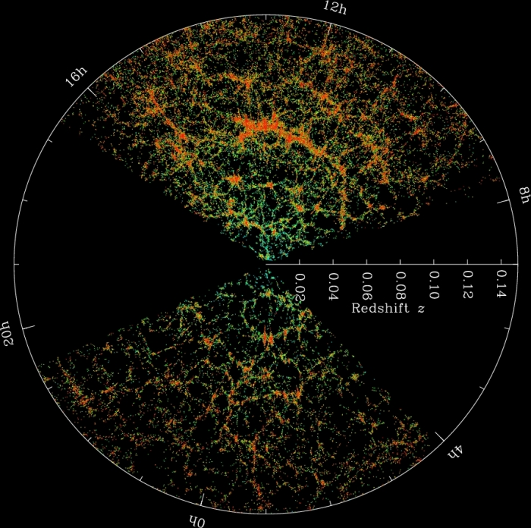
Structure of the universe
Notes:
Remember when I showed you this simulation of the largest scale structures in the entire universe? And the image of galaxies and galaxy clusters it was built to reproduce?
I glossed over a small point. The simulation is of *dark matter*, not gas or stars or galaxies.. Just dark matter.
https://wwwmpa.mpa-garching.mpg.de/galform/virgo/millennium/
Universe: all matter and energy, the sum total of it all
https://www.e-education.psu.edu/astro801/content/l10_p6.html
Observable universe: what we can observe from Earth, likely a very small fraction of the actual universe

Slide 35
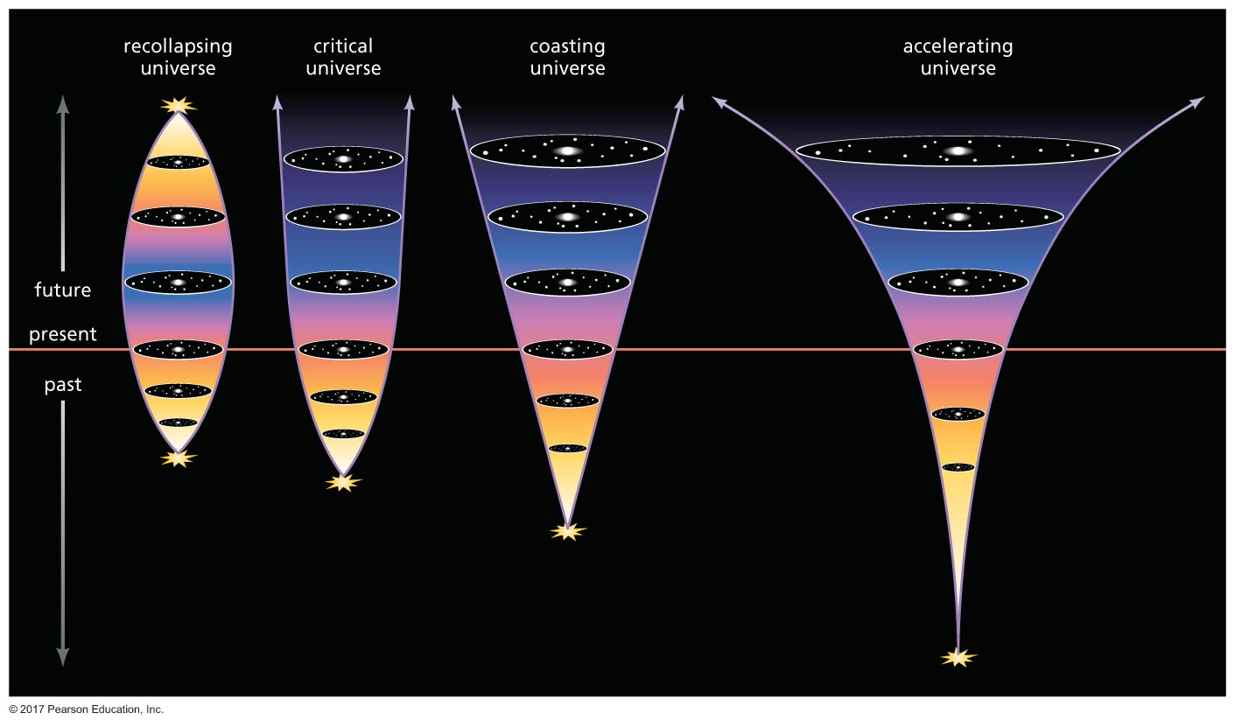
The fate of the universe
Another balance being struck between two forces, inward vs outward:
Gravity
Expansion

Slide 36
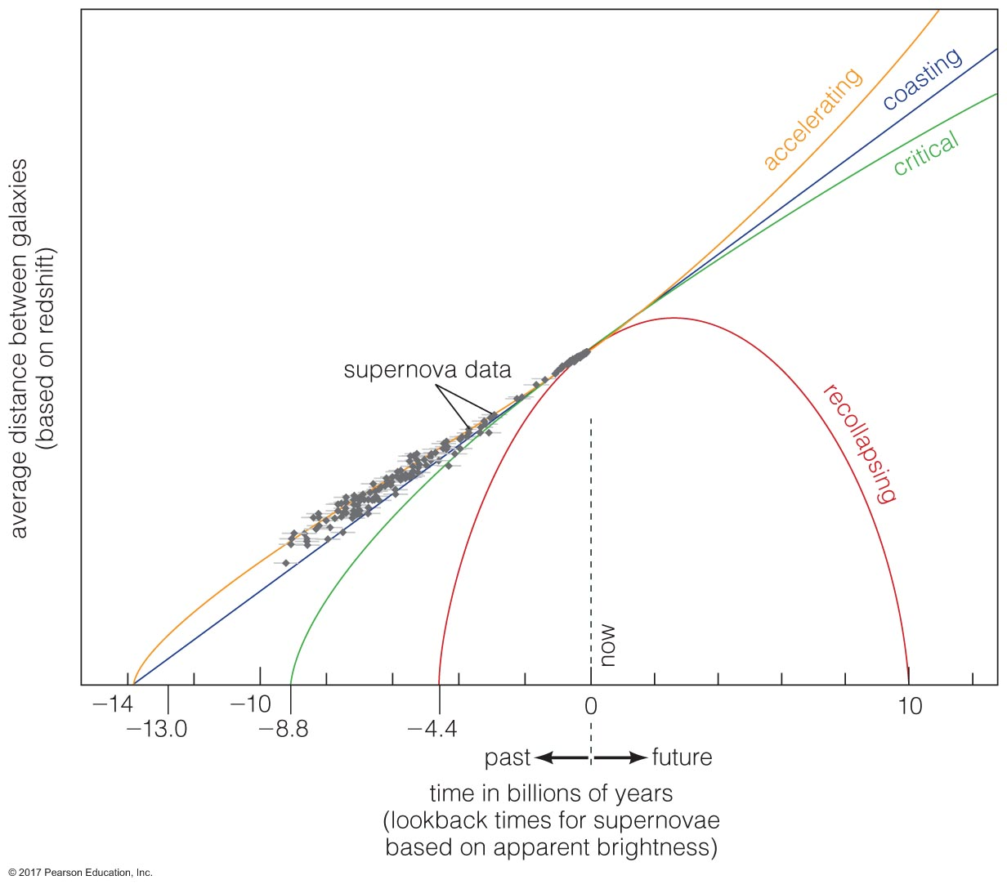
The fate of the universe

Slide 37
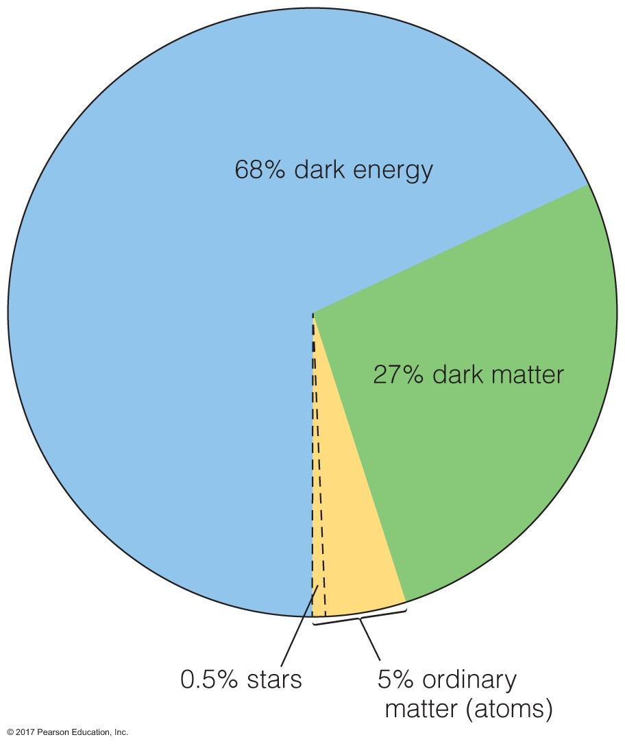
Accelerating universe?
Acceleration discovered in 1998
Nobel prize for discovery in 2011
Acceleration must mean there’s some force driving expansion: dark energy!
Notes:
E=mc^2 shows up again.. The missing mass we haven’t been able to account for could be not mass, but rather, energy!

Slide 38
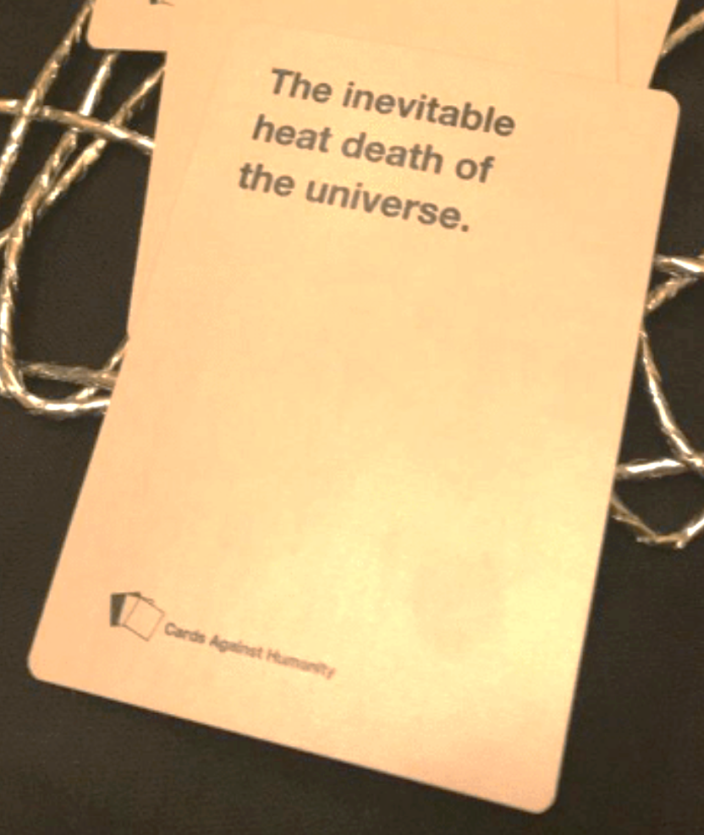
…fate of the universe?
As we know from everything we’ve studied to this point, expansion means cooling. What if dark energy ultimately wins and pulls everything so far apart, and stars stop forming, and the whole universe goes quiet, cold, and dark?
This is, counterintuitively, called the heat death of the universe. (As in, there is no heat left)
This is all so bleak; help us, Carl!
"The basic problem is easily stated … The problem is that the universe is expanding, and there's not enough matter in it to stop the expansion. After a while, no new galaxies, no new stars, no new planets, no newly arisen lifeforms—just the same old crowd. Everything's getting run-down. It'll be boring. So in Cygnus A we're testing out the technology to make something new … Sometime later we might want to close off a piece of the universe and prevent space from getting more and more empty as the aeons pass. Increasing the local matter density's the way to do it, of course."
Notes:
Excerpt from Sagan’s book Contact where Ellie is learning from an alien life form about what they’re trying to do to fend off the heat death of the universe.
Sagan’s thoughts around the fate of the universe are clear and ever optimistic:
1, we have a lot of time to figure out what to do. He pointed out that if we wrote out on a sheet of paper all the 0s in how old the universe would have to be for basic fundamental baryons to break down (protons have half-lives, too!), the paper would be longer than the distance across the universe right now. We’ve got a while!
2, as long as there’s understanding, there’s hope that we’ll be able to figure out what to do.

